Slide 1
What can you do?
Hint: A Lot

Slide 2
Overview
Buying BitCoin
Buying, securing, and Hodling BTC
Privacy
Running a Full Node
What is a Node?
Why run a Node?
Running a Lightning Node
What is Lightning?
Why run a Node?
Mining
???

Slide 3
Buying Bitcoin
The UX is by far the weakest part of Bitcoin right now. However, there are many apps you can use to buy, based on your security, privacy, and price preferences.
BP: Bisq and Hodl Hodl: Decentralized exchanges, direct TX with seller.
Coinbase, Gemini, Bitcoin.com**: Institutional, sell-out, KYC-AML.
ATMs, OTCXs, OpenDime: Physical transfers.
Robinhood, etc.: Some Exchanges only sell you claims to BTC, never use these. Always ensure you can withdraw your coins off-exchange and control Private Keys
*Gemini is run by the Winkelvi.
**Bitcoin.com attempts to scam buyers into buying BCash instead of BTC. Know what you’re buying.

Slide 4
Sidenote: KYC/AML
Know Your Customer / Anti-Money Laundering
A set of laws requiring financial institutions and exchanges to collect all traders’ data: SSN, Credit Card, Phone Number, Photo ID, Passport, etc.
This is antithetical to Bitcoin’s decentralized, censorship-resistant ethos. It is also anti-competitive and difficult to comply with.
Bitcoin and other cryptocurrencies are specifically targeted by these laws, while Wall Street and Institutional banks easily bypass laws, knowingly assist money launderers, and get by with small fines. See: Charlie Shrem.
If you buy on a KYC/AML compliant exchange, anyone (gov’t, hacker, exchange) knows your addresses and can track wherever you send that bitcoin. Forever.

Slide 5
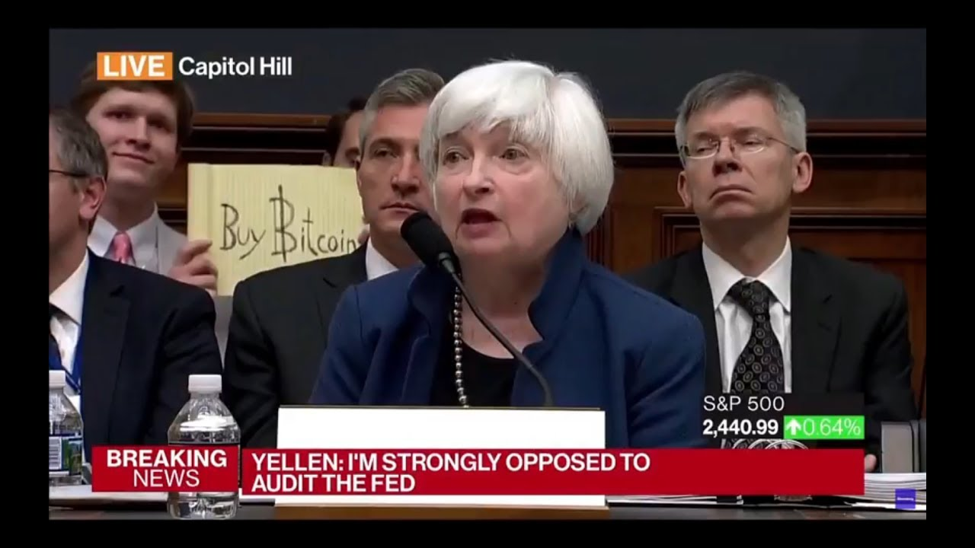
Use CoinJoin

Slide 6
Securing Keys
If you bought off Bisq, you’re good*. If you bought on Coinbase, you need to complete a few steps to ensure security, privacy, and untaxability. Here’s the Process:
Buy on KYC/AML-compliant exchange
Withdraw off-exchange to a Wallet: Samourai, or Wasabi. (BP: Segwit Addresses)
CoinJoin! (or Atomic Swap in the future)
Generate a Paper Wallet (See Process next slide)
Transfer UTXOs (BTC) to Paper Wallet.
Check Blockchain.com to confirm your BTC arrived.
* There’s no harm in CoinJoin-ing anyway, it’s extremely cheap.

Slide 7
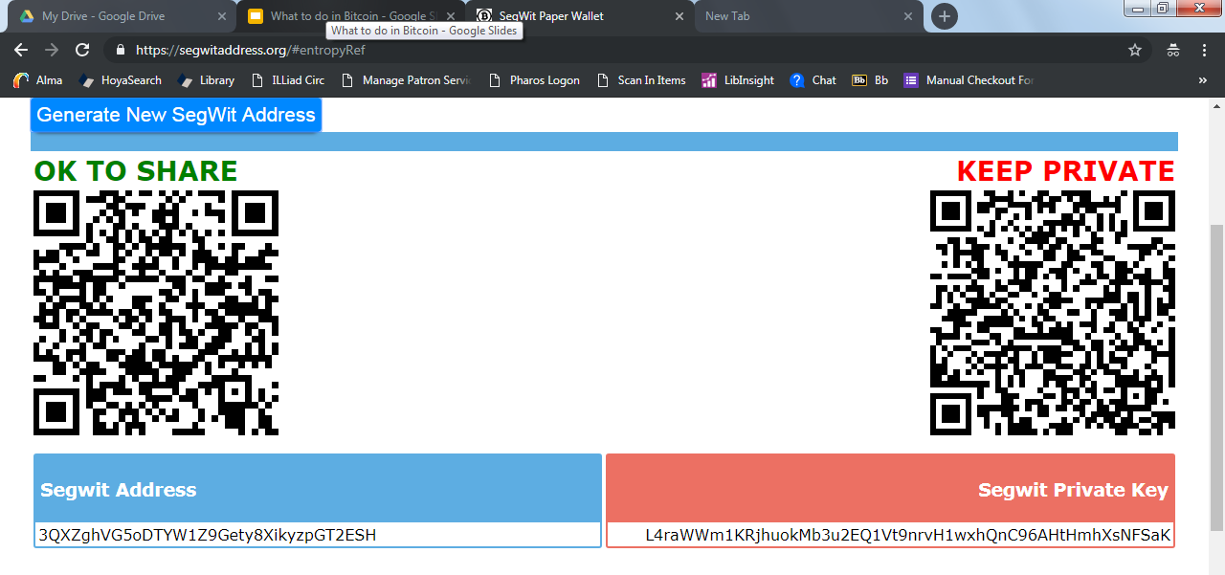
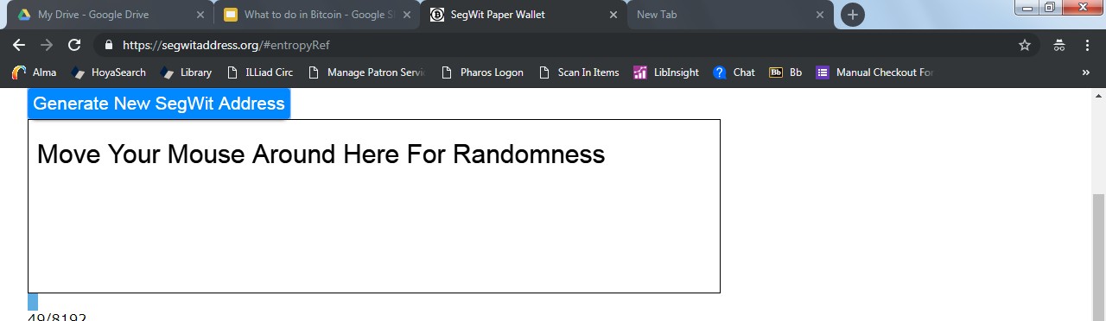
Safely Generating a Paper Wallet (SegWit)
BP(IF): Do this all on a brand-new computer, use a brand new (or at least empty) USB, and do not use a printer (or at least offline). No JS.
Go to https://segwitaddress.org/, hit Ctrl-S (Cmd-S on Mac) to save the page.
You’re saving the HTML file.
Airplane Mode: Turn off Internet, Bluetooth, Ethernet, and cellular.
Run (open) the HTML file. It will open exactly like a website.
This allows you to generate the entropy (randomness), reducing reliance on the computer.
The Result! The Public Key/Address (left, QR & text format) and the Private Key on the right.

Slide 8
Generating a Paper Wallet cont.
Once you have the Key pair, write the Private Key down by hand on a piece of paper, or save the file straight to a USB (not to the computer’s drive), or print it.
These options are all okay, but in descending order. Printers save information and upload it to the internet but they also track where certain paper was printed and when. Screenshots, copy-and-paste, etc. all save data, so they are less secure.
A single typo in your private key will mean you have no access to the funds. Do not misspell anything.
Copy the Public Key (Ctrl-C/V is okay with Pubkey) into Blockchain.com to see your paper wallet’s full history and current funds.
BP: Never reuse Public Keys for multiple transactions. If you withdraw 10% of these funds later, you must move the other 90% to a new wallet (called sweeping). The vulnerability here is small but sweep anyways.

Slide 9
Never Pay Taxes.
Thanks to CoinJoin and your transition to a paper wallet, you have plausible deniability that you even own the BTC. It is nearly impossible for the Gov’t (or anyone) to find your new address. This means never voluntarily report capital gains (profits from selling BTC) or any other info unless you support:
Mass Incarceration
The War on Drugs
Roads
Endless Wars
Everything else the government does.

Slide 10
Running a Full Node
Running a Full Node is the easiest thing you can do to participate and be a real citizen in the network. A Full node does not mine! It only mathematically and cryptographically verifies blocks.
About 200GB of space and 2GB of RAM is required*. To avoid costs later, buy a 1TB (~$50) Hard Drive (SSD preferable). Go to bitcoin.org or GitHub.
With Pruning, you can significantly reduce space requirements, but you’re not fully validating the blockchain. It comes down to how paranoid/authentic you are.
The full blockchain is almost at 570GB. (+6MB/hr)

Slide 11
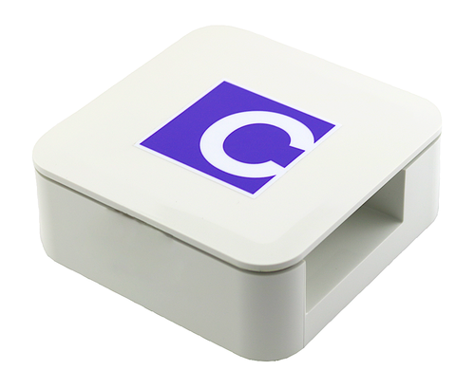
⚡ Running Lightning ⚡
If you’re extra lazy, a Casa by Jameson Lopp is plug-and-play and Controlled from a web browser. Zero Knowledge/ maintenance/setup required.
It’s easy*. The only hangup is that in order to prevent fraud and receive/send payments, you must be online, so ~100% uptime is very important.
Requirements:
A Full Node (as of now, this requirement will go away soon)
Computer you can keep online 24/7 (energy reqs far lower than mining)
Helpful: Very limited familiarity with Command Line
Pierre Rochard’s guide.
Zap.
Joule Chrome Extension.
If you don’t want/have a laptop to run 24/7, A Raspberry Pi 3 works, but is much less simple and requires more Command Line.

Slide 12
Mining
High investment, high energy cost, low margins.
And I don’t know anything about how to do it.
But, it’s not too complicated thanks to Bitmain. BTC Mining equipment is built solely to mine BTC (not BCH, ETH, etc.) These are called ASICs, and should be fairly easily to set up.
While Nodes can decide what software to run (what forks to accept), Miners have significant leverage over the direction of the system.

